Slide 1


PY-EXPO
2K24
Team ID: T111
Team Name: GREENHORN CODERS
Genius innovation leaves behind a legacy...
PYEXPO 2K24

Slide 2
PS Code: PY43
PROBLEM STATEMENT:
1. To develop a python based program to detect and analyse the type of vehicles and count of the vehicle.
2. To avoid the count of securities and to make profit .
PYEXPO 2K24

Slide 3
SOLUTION:
1.Our project is focused on to save the cost of paying securities.
2.We can able to reduce the number of securities here.
3.Can able to detect the vehicle count and type of the vehicle.
4.Deep learning is used in this source code.
TECHNOLOGY STACK:
Technology stacks used here:
PYTHON,YOLOv8
PYEXPO 2K24

Slide 4
TEAM MEMBERS
TEAM CHIEF:
Jeevitha M 23CB24
TEAM MEMBERS:
Swetha V 23CB57
Kalaivani B 23CB26
Shri loshini U .T 23CB53
PYEXPO 2K24

Slide 5
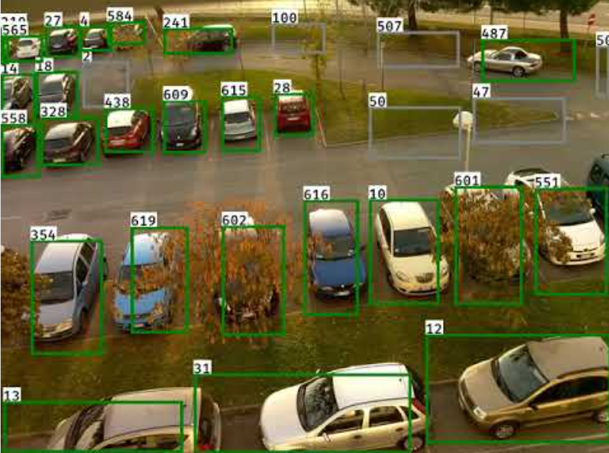
https://github.com/MuhammadMoinFaisal/YOLhttps://images.app.goo.gl/XvR3oZYCFkp6kUkX7Ov8_Segmentation_DeepSORT_Object_Tracking.git
04
PYEXPO 2K24

Slide 6
Thank You
PYEXPO 2K24

